Slide 2
Robot Swarm Theory Applicable to Seek and Rescue Operation
José León León¹ Andres Botello² Gustavo Cardona³ Juan Manuel Calderón⁴
^{1,4}Dept of Electronic Engineering, Universidad Santo Tomás, Colombia
^{2,4}Dept of Electrical Engineering, University of South Florida, Tampa, Fl, USA
³Department of Electrical and Electronics Engineering, Universidad Nacional, Colombia
¹joseleonl@usantotomas.edu.co {²abotello, ⁴juancalderon}@mail.usf.edu
³gacardonac@unal.edu.co
December 15 of 2016

Slide 3
Types of disaster
Natural
Flood, cyclone, drought, earthquake, cold wave, thunderstorms, heat waves, mud slides, storm and so on [1].
Man-made
Setting of fires, epidemic, deforestation, pollution due to prawn cultivation, chemical pollution, wars, road\train accidents, riots, food poisoning, industrial disaster\crisis, environmental pollution and so on [1].

Slide 4
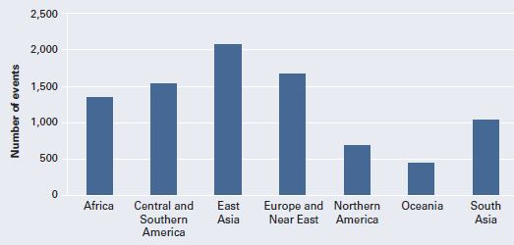
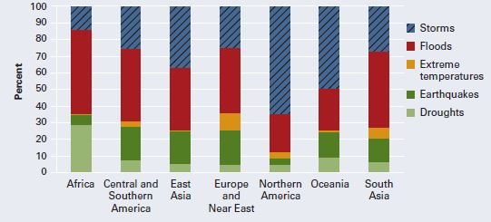
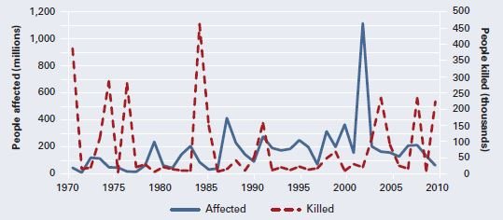
Global natural hazard databases 1970-2010
Figure 1. Disasters [2].
Figure 2. Types of disaster [2].
Figure 3. Victims [2].

Slide 5
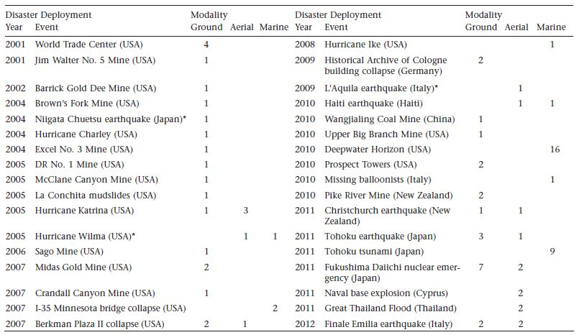
Robots in disasters
Table 1. Robots assisting in disasters[3].

Slide 6
Problem and approach
Problem
After the collapse of a constructed urban structure and in front of a scenario of great destruction, the response time to find and locate the trapped survivors is crucial [4], these scenarios are characterized by a great number of obstacles in An irregular terrain and no cohesion of the same, which makes difficult the exploration, search and location of potential victims.
Approach
In insect swarms, extensive soil exploration work is carried out to identify and locate targets such as bees, ants and termites. The implementation and development of swarms behavior in robotics allows the solution of complex problems with simple structures. In research and localization of civilians in an efficient way investigations are carried out that involve the robotics of swarms for their flexibility, allowing to carry out these tasks efficiently.

Slide 7
Algorithm of swarm
The Algorithm used to simulate the swarm behavior is based on the one proposed by Passino [5]. This algorithm is explained as follows.
Each agent is described as a point in the space with position and velocity. Initially, the position and velocity are defined randomly.
We assumed that each agent can detect the position and velocity of the rest of the swarm agents.
The interaction of the swarm agents is defined by the attraction and repulsion strategy. This strategy allows the agents to keep a comfortable distance over the other swarm agents.

Slide 8
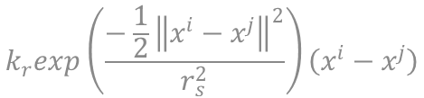

Forces of attraction and repulsion
Attraction
$${−k}_{a}\left(x^{i}−x^{j}\right)$$
Repulsion
$$k_{r}exp\left(\frac{−\frac{1}{2}{\left\|x^{i}−x^{j}\right\|}^{2}}{r_{s}^{2}}\right)\left(x^{i}−x^{j}\right)$$

Slide 9

Enviroment
The obstacles and victims that must be found by the agents are part of the environment. For the current work, both elements generate forces of repulsion and attraction over the agents. In this way, the interaction between agents with victims and obstacles is modeled using equation
$$k_{r}exp\left(\frac{−\frac{1}{2}{\left\|x^{i}−x^{j}\right\|}^{2}}{r_{s}^{2}}\right)\left(x^{i}−x^{j}\right)$$

Slide 10
Left Behind
Every agent is exposed to diferent attraction and repulsion forces, which help to keep the swarm cohesion and at same time pushes the swarm towards the goal. The victims generate an attraction force over close agents and this force can disturb the normal behavior of the swarm and reduce the velocity of the agents in proximity to the victims. The k_{r} magnitude was put in place so that it can stop at least one of the closest agents near the victims. When agents are navigating close to the victims, at least one agent must stop near the victims. Once one or more agents stop beside to the victims, those agents are left behind by the swarm. They are separated from the swarm, breaking the communication and attraction forces that keep them into the swarm. The agents left behind create a new smaller swarm close to the victims, which changes its status to stationary with the victims and the starts to transmit the localization of the newly found victims.

Slide 11
Experiment
Result
The first version of this experiment is performed using 10 agents and small obstacle as shown in Fig.(4). This part of the experiment depicts how the swarm goes around the obstacle in order to avoid it. This is possible, because the obstacle is relatively small and the agents are able to tolerate the obstacle between the attraction forces.
Figure 4. Navigation with a Small Obstacle.
The second version uses a bigger obstacle as depicted in Fig.(5). In the second case, the agents avoid the obstacle by taking a side path, this occurs because there is not enough space between the attraction forces to allow broad obstacles to stay in between the agents.
Figure 5. Navigation with a Big Obstacle.

Slide 12
Experiment
Result
This part of the experiment depicts how the swarm goes around obstacles in order to avoid them. This is possible, because the obstacles are relatively small and the agents are able to tolerate the obstacles between the attraction forces, as depicted by Fig.6. This case uses nine obstacles distributed throughout the area between the start point and the goal point. It forces the swarm to navigate through the obstacles. while avoiding them and moving towards to goal point. Figure 6 shows the agents navigating and exploring the zone. At same time, the path described by every agent is drawn and it depicts the explored area.
Figure 6. Navigation with Several Obstacles.

Slide 13
Experiment
Result
This test uses a at terrain to show how the swarm localizes victims. This process is accomplished with the use of the "left behind" process. Once an agent has localized a victim, it stops near the potential victim. At the same time, the swarm stops, because of the attraction force between the agents. In that moment the process called "Left behind" detaches the agents found victims. The detached agents create a new swarm surrounding the victims. The original swarm restarts to move towards the target point and leaves behind the swarm agents that are in charge of the victims. Figure (7) shows how the agents stop near the victims and surround them, while the swarm leaves them behind.
Figure 7. Search of Victims Area.

Slide 14
Experiment
This is a complete case where the swarm navigates through the area full of obstacles and some places with potential victims. This test is divided in two experiments. The first one uses 10 agents and 2 victim places as shown by Fig. 8. The second one has 40 agents and 5 victim places (Fig. 9). Both cases depict how the swarm covered the area navigating through obstacles and localizing victims at the same time. The performance differences between these two cases are the covered area and the number of agents surrounding the victims in independent clusters. With large numbers of agents, the covered area is bigger, because the repulsion force pushes the agents harder to keep the distance between them. These agents use more area, to find an equilibrium point of repulsion and attraction forces. The number of agents around victims is also bigger, because there are more agents in the swarm and therefore rises the probability of finding victims for each agent.

Slide 15
Result
Figure 8. Victims Zone with multiples Obstacles.
Figure 9. Several Victim Areas with a Big Swarm.

Slide 16
Conclusions
The algorithm shows creation of new small swarms around victims, which can be used to support and facilitate the localization of victims for rescue teams.
The swarm algorithm shows redundancy and robustness characteristics when it loses agents, but it regroups with the ones that are left and keeps the navigation process.
Future work includes the use of algorithms based on graph theory to improve the relation of the sub swarms and the global swarm.
The algorithm proposed in the current work will be performed in a robotics simulator with the purpose to check this ideas on aerial and ground robots.

Slide 17
References
[1] B. K. Singh, Handbook of Disaster Management: Techniques and Guidelines (1). Delhi, IN: Rajat Publications, 2008.
[2] The World Bank, World Bank, y United Nations (UN), Natural Hazards, UnNatural Disasters. Herndon, US: The World Bank, 2010.
[3] R. R. Murphy, Disaster Robotics. Cambridge, US: The MIT Press, 2014.
[4] R. Ventura y P. U. Lima, \Search and Rescue Robots: The Civil Protection Teams of the Future", en 2012 Third International Conference on Emerging Security Technologies (EST), 2012, pp.12-19.
[5] K. M. Passino, Biomimicry for Optimization, Control, and Automation. Springer Science & Business Media, 2004. ISDA 2016

