Slide 1

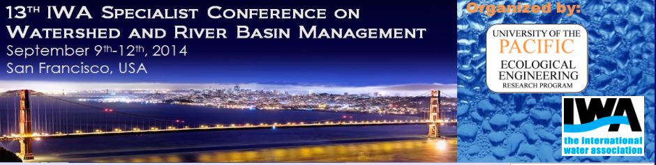

A New method to measure slope in large rivers using tracers.
C.A. Peña-Guzmán* A.J. Constain, D.J. Mesa, J.L. Corredor
* Santo Tomas University, Bogotá, Colombia, carpeguz@gmail.com

Slide 2
INTRODUCTION

Slide 3
ELDER’S EQUATION
h= depth.
S=slope.
E=longitudinal dispersion coefficient.
In 1959 J.W, Elder proposed an equation which involves the slope as a function of dispersive transport

Slide 4
SOME PROBLEMS TO EXTENT ELDER´S EQUATION TO NATURAL STREAMS
The obtained data for E were smaller than those calculated as “reference values” by means of the “Routing procedure”, a method considered in that time as the ideal one.

Slide 5
A MODERN REVIEW OF ELDER´S EQUATION
Validity of “Routing procedure” as a reference method to calculate E
Equivalence of vertical and transverse distribution of velocities in a turbulent flow.
The longitudinal dispersion coefficient as function of time

Slide 6
small or narrow river
Large or wide river

Slide 7
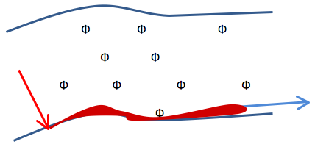
= State function.
V_{dis}= Mean dispersion velocity.
U = Advection velocity.
R = hydraulic radius.
= characteristic time.
F = Estimation function.
If F≈5.93 the slope is probably a good value for the considered stream

Slide 8
APPLICATION ON THE RIVER META

Slide 9
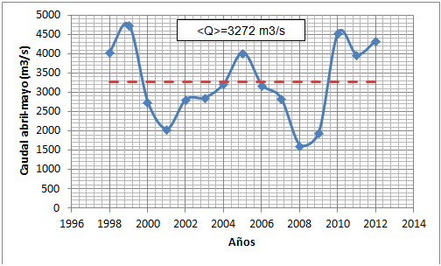
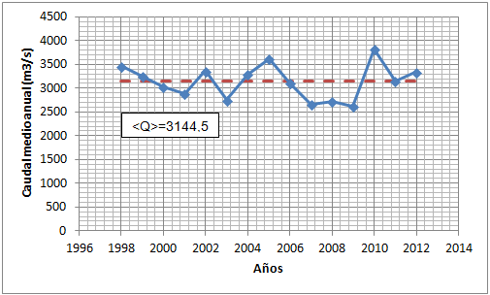
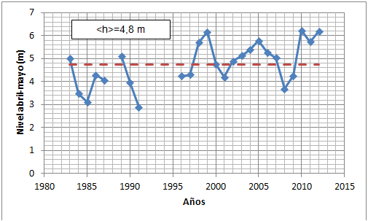
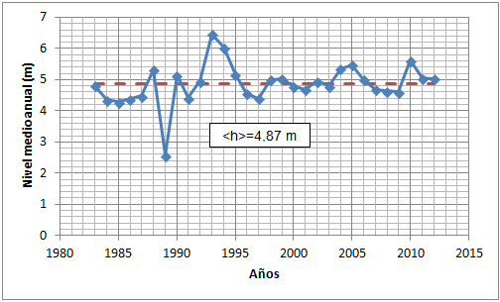

Slide 10
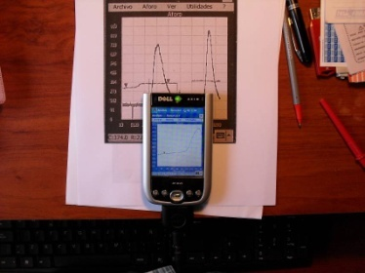
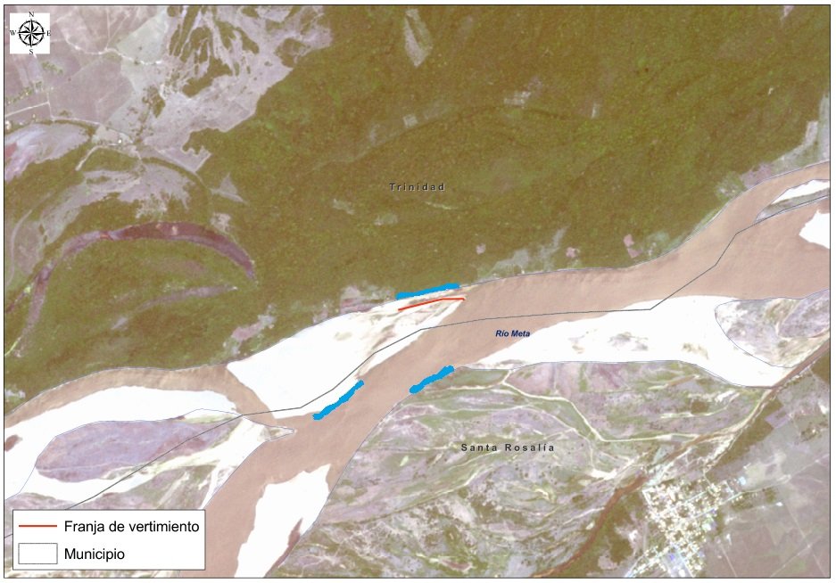
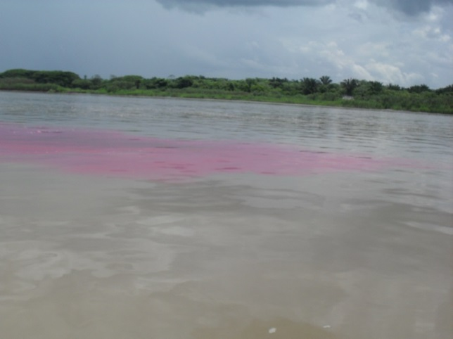
Casanare and Casanare 1
INIRIDA DEEP FLOW
Vichada and Vichada 1

Slide 12
(*) It is a gross mistake and it is not taken into account.

Slide 13
CONCLUSIONS
1.-It is important to remark that the simplicity and easy application of the new method may be very useful in certain cases where data is too difficult to obtain by other methods.
2. - This new method may help to known congruent values in geomorphology applied to water quality studies.
4. - Obtained results in Meta River in Colombia validate the se of RWT tracer as useful in measuring tasks in large rivers, if transport coefficient is a time function applied to Elder´s equation.

Slide 14
THANKS FOR YOUR ATTENTION

