Slide 1






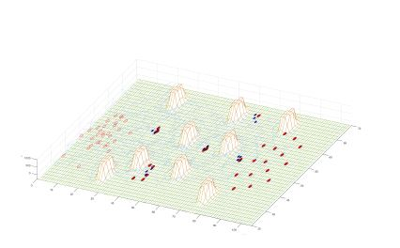



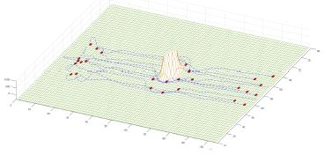
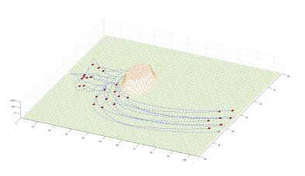

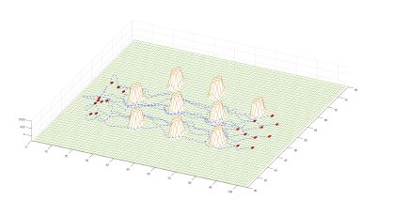
PAPER 139
16TH INTERNATIONAL CONFERENCE ON INTELLIGENT SYSTEMS DESIGN AND APPLICATIONS
Robot Swarm Theory Applicable to Seek and Rescue Operation
AUTHORS
José León León; Andres Botello; Gustavo Cardona; Juan Manuel Calderón
ABSTRACT
ALGORITHM
An important application of cooperative robotics is search and rescue of victims in disaster zones. The cooperation between robots requires multiple factors that need to be taken into consideration such as communication between agents, distributed control, power autonomy, cooperation, navigation strategy, locomotion, among others. This work focuses on navigation strategy with obstacles avoidance and victims localization. The strategy used for navigation is based on swarm theory where each robot is an swarm agent. The calculation of attraction and repulsion forces used to keep the swarm compact is used to avoid obstacles and attract the swarm to the victim zones.
The Algorithm used to simulate the swarm behavior is based on the one proposed by Passino [2]. This algorithm is explained as follows.
Each agent is described as a point in the space with position and velocity. Initially, the position and velocity are defined randomly.
We assumed that each agent can detect the position and velocity of the rest of the swarm agents.
The interaction of the swarm agents is defined by the attraction and repulsion strategy. This strategy allows the agents to keep a comfortable distance over the other swarm agents.
Figura 4. Victims Zone with multiples Obstacles.
CONCLUSIONS
INTRODUCTION
RESULTS
The algorithm shows creation of new small swarms around victims, which can be used to support and facilitate the localization of victims for rescue teams.
The swarm algorithm shows redundancy and robustness characteristics when it loses agents, but it regroups with the ones that are left and keeps the navigation process.
Future work includes the use of algorithms based on graph theory to improve the relation of the sub swarms and the global swarm.
The algorithm proposed in the current work will be performed in a robotics simulator with the purpose to check this ideas on aerial and ground robots.
When a disaster occurs, the most critical steps that need to be followed in order to save lives are exploration, search, localization and rescue of survivors. Each step is accompanied by a set of challenges for rescue teams, because affected areas are difficult to access and are extremely dangerous, for example they might have uneven grounds, which are prone to landslides, or collapsed buildings, among other possible scenarios. Fortunately, we have seen significant progress in the interaction between rescue workers and robotic platforms used in rescue operations, as shown in the work presented by Casper in [1], which deals with the events presented in the attacks of the World Trade Center. This type of work has allowed the public to see the advantages, disadvantages and applicability of robotics in disaster zones.
Figura 1. Navigation with a Small Obstacle.
The use of swarms of robots in exploration of disaster zones facilitates and streamlines rescue tasks, thus making the recognition and mapping of affected areas faster and safer for rescue workers, while providing more information for search-and-rescue of possible survivors.
REFERENCES
Figura 2. Navigation with a Big Obstacle.
  1. J. Casper y R. R. Murphy, “Human-robot interactions during the robot-assisted urban search and rescue response at the World Trade Center”, IEEE Trans. Syst. Man Cybern. Part B Cybern., vol. 33, nÃºm. 3, pp. 367-385, jun. 2003.
  2. K. M. Passino, Biomimicry for Optimization, Control, and Automation. Springer Science & Business Media, 2004.
Figura 3. Navigation with Several Obstacles.

